Slide 1
Smart Inventory Insights
ETL Project using Python | MySQL | Power BI
Name: Niten Kadel
Course Name: Building Successful Teams
Professor: Hachem Sfar

Slide 2
Objective
Goal:
Improve business growth and product strategy through inventory intelligence using open-source food data.
Key Objectives:
Clean and consolidate nutrition data
Analyze brand and product health
Enable data-driven decision-making

Slide 3
Data Source
Source: Open Food Facts API | Public, free API with product nutrition data
Focus: Category = “Snacks”
Sample Data: Brand, Product, Nutri-Score, Energy, Quantity, Countries

Slide 4
ETL Pipeline Overview
Process:
E - Python: Extract snack products via API
T - Pandas: Clean columns, fix grades & units
L - MySQL: Load cleaned data into 'snacks' table
Extract
Python
Transform
Python
Pandas
Load
MySQL
Visualize
Power BI

Slide 5
Power BI Dashboard
Tools: Power BI Desktop
Visualizations:
Donut Chart (Nutri-Score Distribution)
Brand vs. Nutri-Score (Stacked Column)
Top 5 Energy-Dense Products (Bar Chart)
Inventory Risk (Scatter Plot)

Slide 6
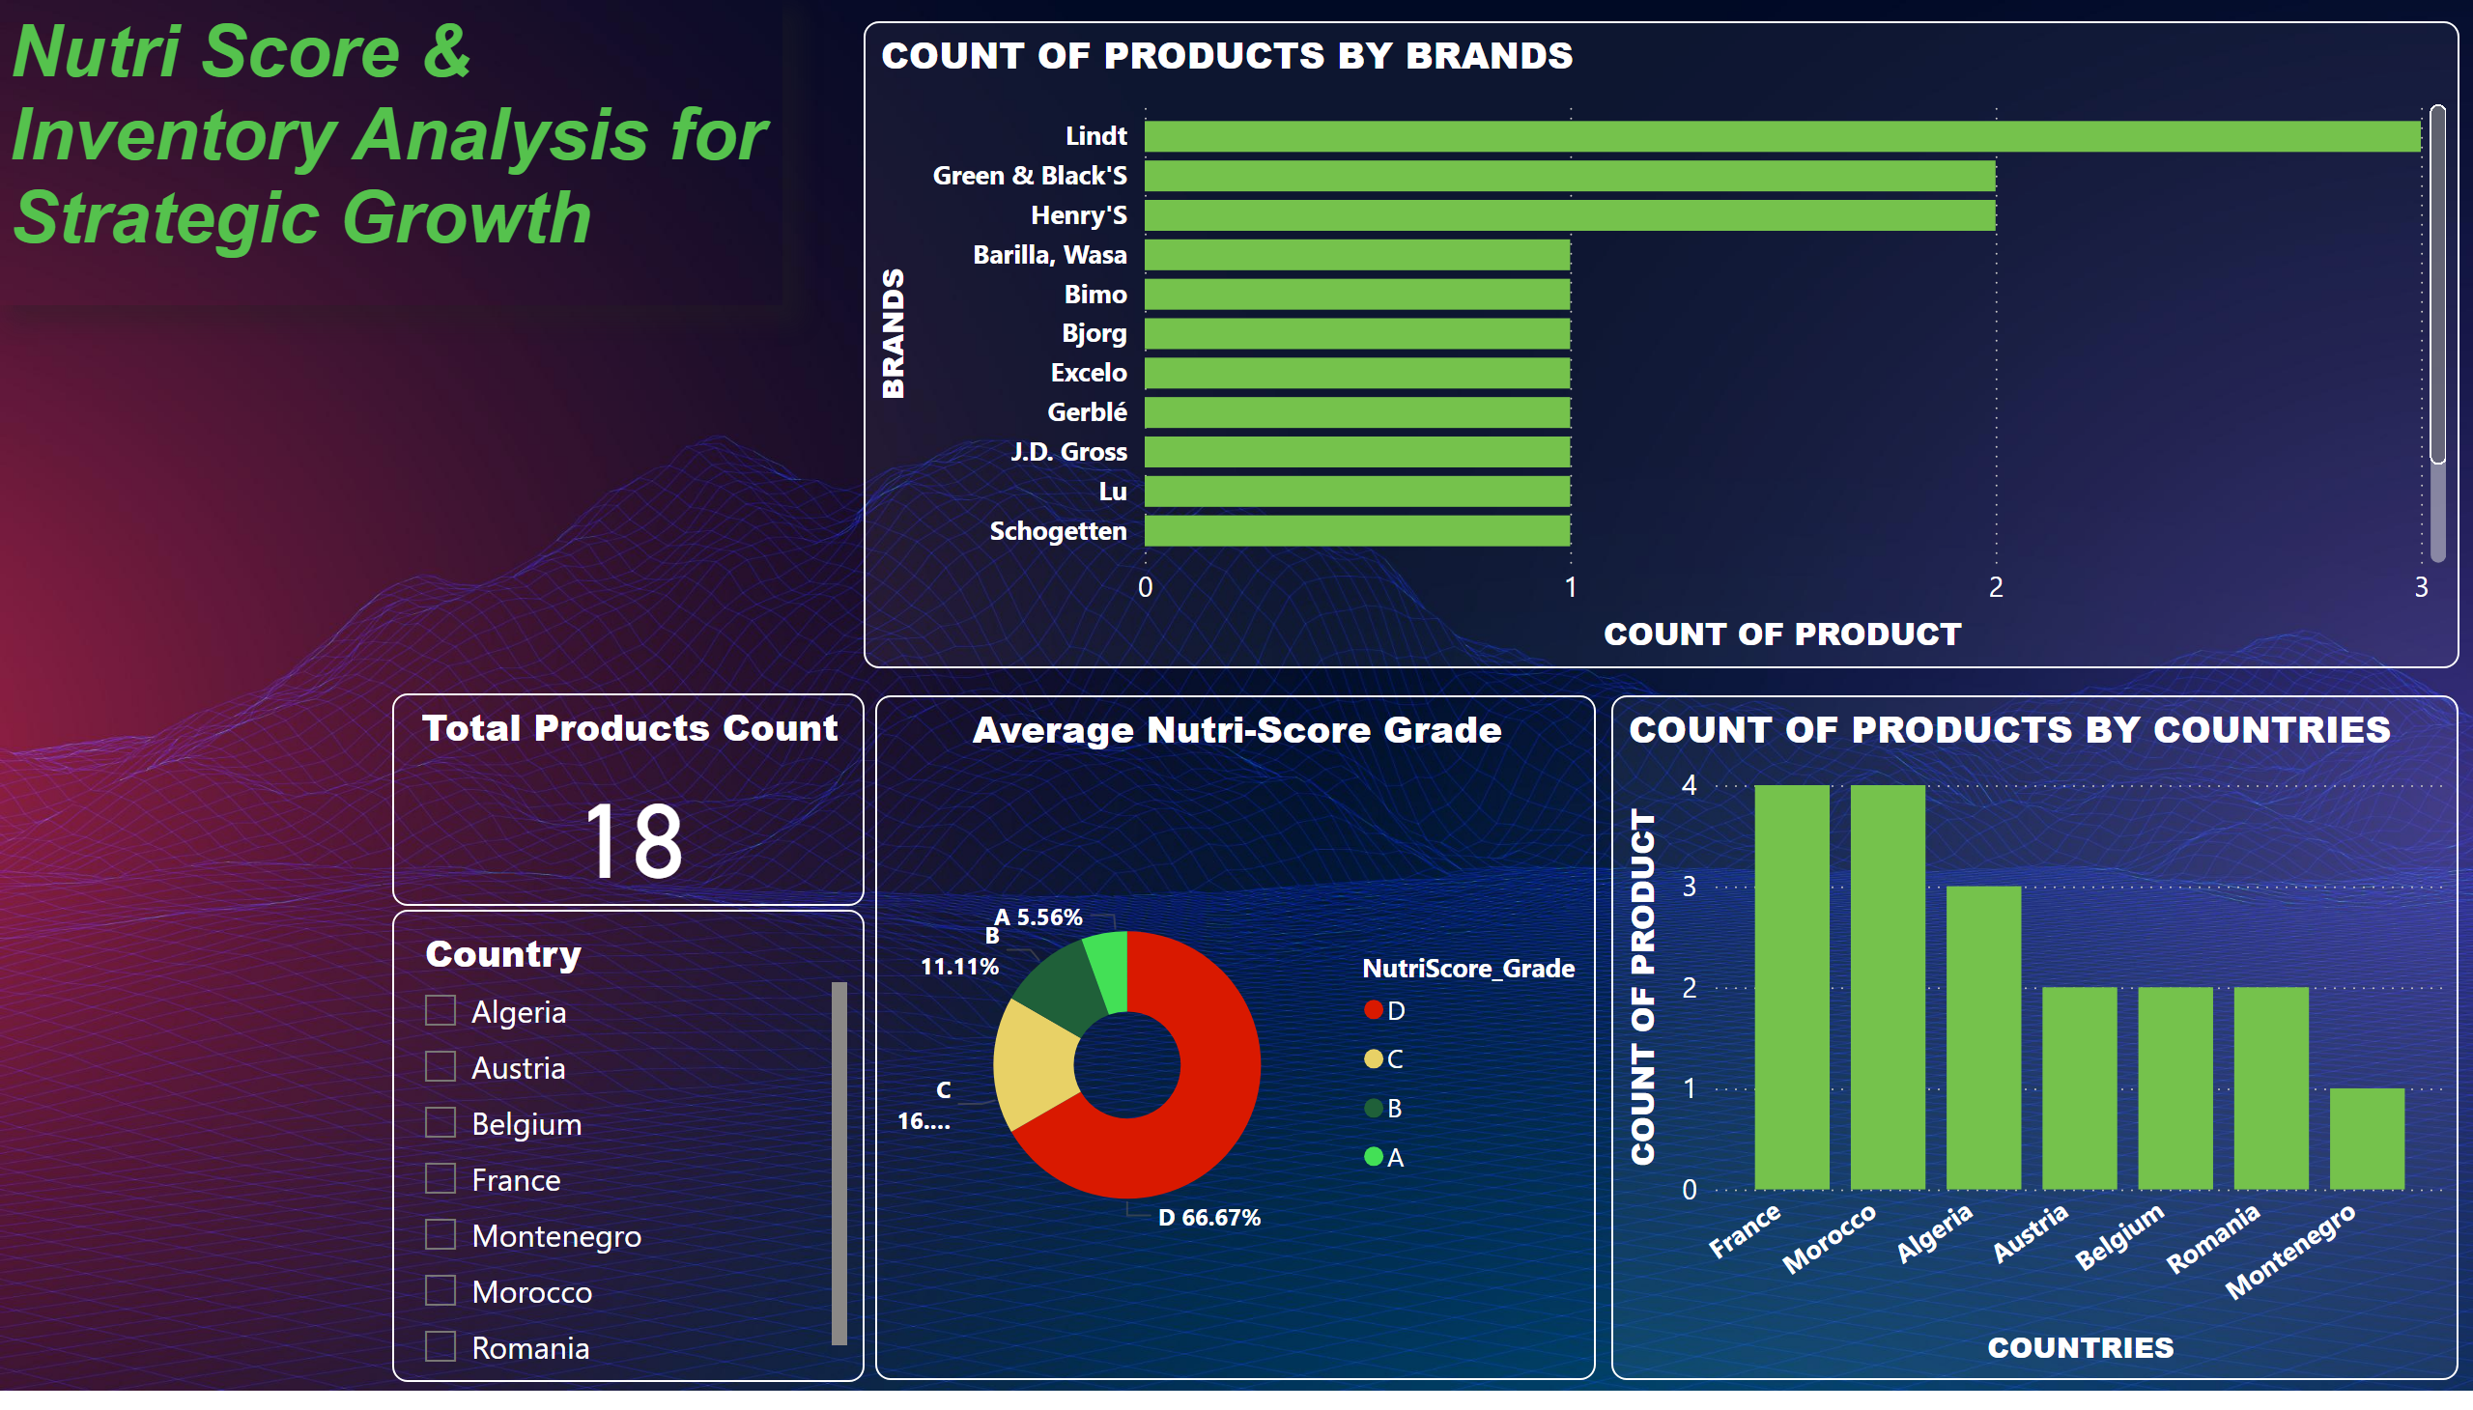
Basic Overview Charts
Notes:
Total Products Count
No alt text provided
COUNT OF PRODUCTS BY BRANDS
No alt text provided
Country
No alt text provided
COUNT OF PRODUCTS BY COUNTRIES
No alt text provided
Average Nutri-Score Grade
No alt text provided
textbox
No alt text provided

Slide 7
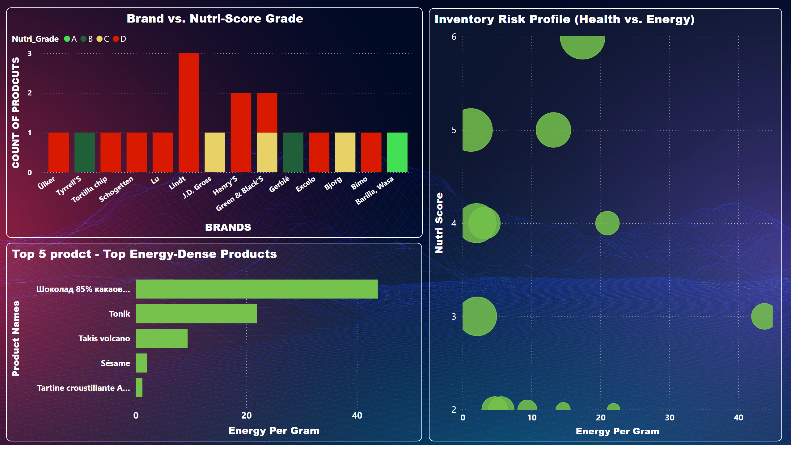
Key Growth Charts
Notes:
Brand vs. Nutri-Score Grade
No alt text provided
Top 5 prodct - Top Energy-Dense Products
No alt text provided
Inventory Risk Profile (Health vs. Energy)
No alt text provided

Slide 8
Business Insights
Key Growth Drivers:
60% of products are in NutriScore C–E: Health risk
Top brands are dominated by low-NutriScore items
High energy-density items clustered among 3 brands
Recommendations:
Replace or promote healthier brands
Target marketing on A–B rated products
Reformulate D–E grade products

Slide 9
Thank You
Q&A
GitHub link: https://github.com/Niten31/Niten31.git

